Slide 1

Agentic AI Builder: Low-Code AI Agents & Voice Agents in n8n
Week 2
Day 5

Slide 2
3 Weeks to Agentic AI Builder
Core skills
Integrations
Projects
Week 3: Amplify with multi-agent systems and MCP
Self-hosted n8n and Local LLMs
Advanced Integrations
MCP
Context Engineering, Sub-Agents
Capstone: Amplify your business
Week 2: Accelerate with Voice Agents and RAG
Voice Agents with ElevenLabs
Integrating ElevenLabs and n8n
RAG and Agentic RAG
Supabase Vectors and Data ingest
Product Expert Voice Agent
Week 1: Automate with workflows in n8n cloud
First n8n AI Agent Live
Foundations: Agentic AI and n8n
Integrations with docs and email
Data and integrations
Daily Portfolio Rebalancer

Slide 3


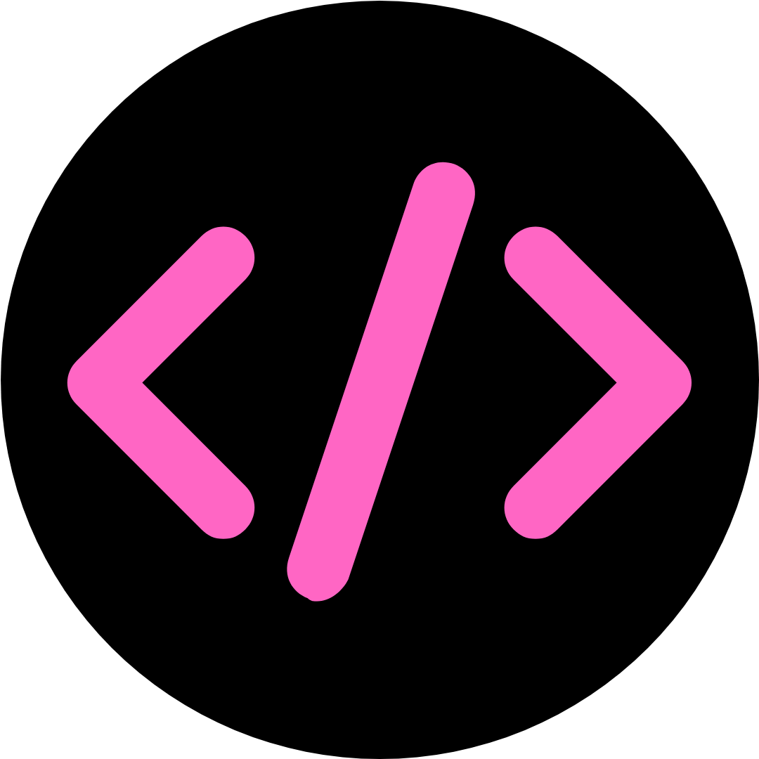

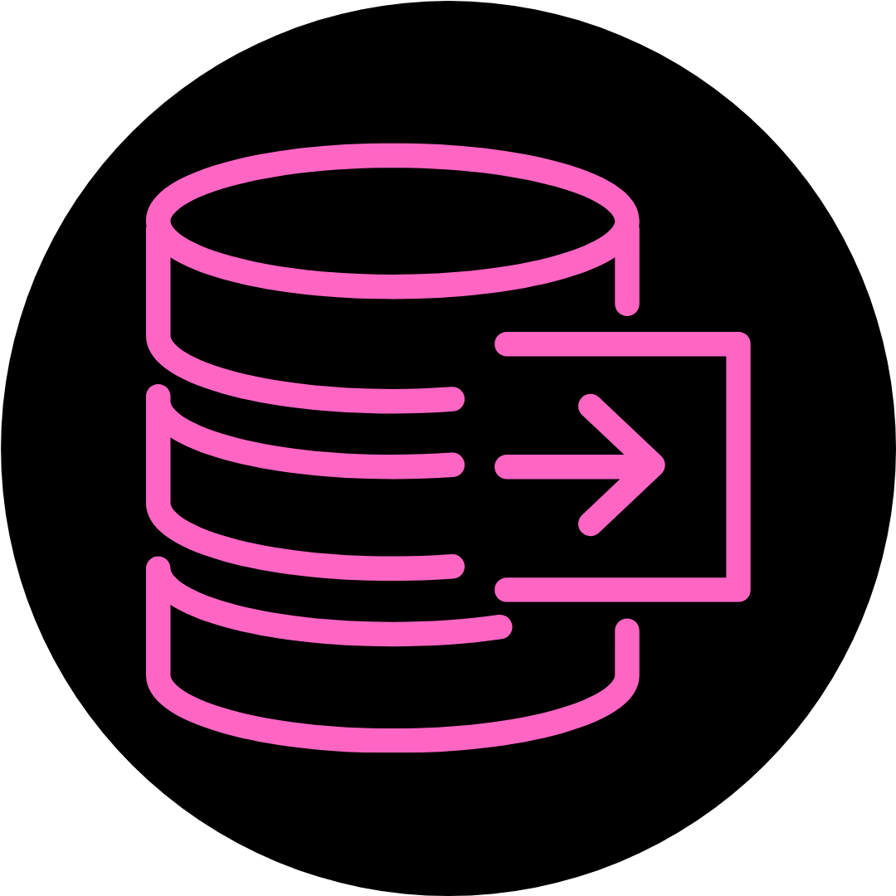
The big idea behind RAG
Embedding LLM
Vectorize
Question
Prompt
Answer
Response
Chat
n8n
LLM
Retrieve
Vector Datastore

Slide 4
Two Phases of RAG
Data Ingest
Extract
Trans-
form
Chunk &
Vectorize
Load
Data
Source
Vector Store
RAG pipeline / Question Answering
Chat
Agent
LLM (workflow & response)
Vectorize
Vector Store

Slide 5
Business Challenge
Absolutely classic business setup:
Build an Expert to answer in-depth questions for your client. The client has a number of products in a massive Google sheet
For our solution we will use Supabase:
A popular cloud provider of Postgres databases.
More advanced than using the Simple Vector databases built into n8n, and there some code to copy & paste.
Yesterday we worked on Data Ingest:
Interesting work: mapping the data from one format to another using the Edit Fields node
Shortcut: Google Sheet for product data
Today we add Question Answering and then Voice

Slide 6
Voice + Workflow
Two integration patterns
n8n orchestration
End-to-end workflow in n8n
Call ElevenLabs API for TTS
Call ElevenLabs API for STT
ElevenLabs orchestration
Voice Agent in ElevenLabs
Have a tool that calls n8n
Business workflow in n8n
Benefits:
Simple
All workflow in one place
More switchable API
Benefits:
Low latency
Best of both products
Advanced Voice features

Slide 7
Deeper terminology on APIs
You don’t need to remember this! We will review often.
“Calling an API” is achieved by making a web request using HTTP, the language of the internet
The URL is known as an Endpoint
“I’m calling an API by making an HTTP request to an Endpoint”
When you’re on the receiving end, and you want someone to call your URL when they have information for you, that endpoint is known as a Webhook
“I’ve set up a Webhook - make an HTTP request there to notify me about X” or “Tell me your Webhook so I can notify you”
There are different flavors of HTTP Request, called the Method:
The most common are GET and POST
GET is usually used to fetch information
POST is usually used to send information with JSON in the body

Slide 8
3 Weeks to Agentic AI Builder
Core skills
Integrations
Projects
Week 3: Amplify with multi-agent systems and MCP
Self-hosted n8n and Local LLMs
Advanced Integrations
MCP
Context Engineering, Sub-Agents
Capstone: Amplify your business
Week 2: Accelerate with Voice Agents and RAG
Voice Agents with ElevenLabs
Integrating ElevenLabs and n8n
RAG and Agentic RAG
Supabase Vectors and Data ingest
Product Expert Voice Agent
Week 1: Automate with workflows in n8n cloud
First n8n AI Agent Live
Foundations: Agentic AI and n8n
Integrations with docs and email
Data and integrations
Daily Portfolio Rebalancer

Slide 9

Agentic AI Builder: Low-Code AI Agents & Voice Agents in n8n
67%
Complete

